Slide 1
Gravity Search Algorithm
based on paper by Rashedi, Nezamabadi-pour, Saryazdi, 2009
presentation by Nataliia Zubareva

Slide 2
Problem
optimization problems
high dimensionality
exhaustive search doesn’t work
heuristic optimization methods
no universal solution
Heuristics are techniques which seek good (near-optimal) solutions at a reasonable computational cost without being able to guarantee either feasibility or optimality
=>
Notes:
In solving optimization problems with a high-dimensional search space, the classical optimization algorithms do not provide a suitable solution because the search space increases exponentially with the problem size, therefore solving these problems using exact techniques (such as exhaustive search) is not practical

Slide 3
Applications
optimization of objective functions
pattern recognition
control objectives
image processing
filter modeling

Slide 4

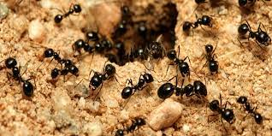

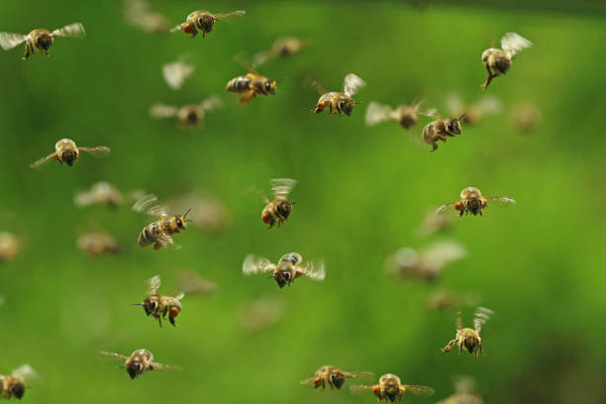
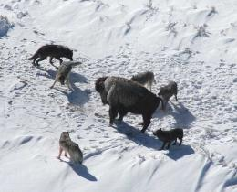
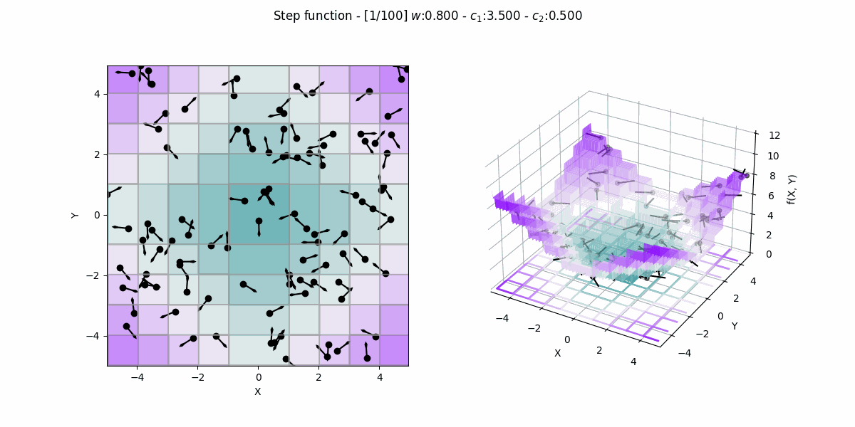
Notes:
heuristics nature
swarm behaviours

Slide 5
Common principles
search in a parallel
multiple initial points & agents
each member executes a series of operations and shares information with others
randomized search
positive feedback
negative feedback
multiple interactions
no central controller
Notes:
To avoid trapping in a local optimum, the algorithm must use the exploration in the first few iterations. Hence, the exploration is an important issue in a population-based heuristic algorithm. By lapse of iterations, exploration fades out and exploitation fades in, so the algorithm tunes itself in semi-optimal points. To have a high performance search, an essential key is a suitable tradeoff between exploration and exploitation. However, all the population-based heuristic algorithms employ the exploration and exploitation aspects but they use different approaches and operators. In other words, all search algorithms have a common framework.

Slide 6
exploration - expanding search space
exploitation - finding the optima around a good solution
In each iteration each member performs:
self-adaptation - improve performance
cooperation - information transferring
competition - compete to survive
=>

Slide 7
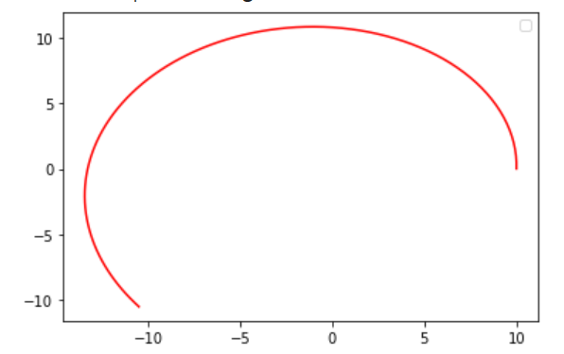
Gravity Search Algorithm
searcher agents are a collection of masses
interact with each other based on the Newtonian gravity and the laws of motion
Classical gravity search

Slide 8
Laws
F = G * (M1 * M2)/ R^2
F - gravitational force,
G -gravitational constant,
M1, M2 - masses of first and second particles respectively,
R - distance between particles
a = F / M
a - acceleration experienced by a body,
F - force applied to the body,
M - its mass
G(t) = G(t0) * (t0/t)^b
G(t) - gravitational constant at time t, G(t0) - gravitational constant at the first cosmic quantum-interval of time t0,
b - degradation constant, < 1
‘‘Every particle in the universe attracts every other particle with a force that is directly proportional to the product of their masses and inversely proportional to the square of the distance between them”.
Notes:
he gravitation is the tendency of masses to accelerate toward each other. It is one of the four fundamental interactions in nature [30] (the others are: the electromagnetic force, the weak nuclear force, and the strong nuclear force). Every particle in the universe attracts every other particle.

Slide 9
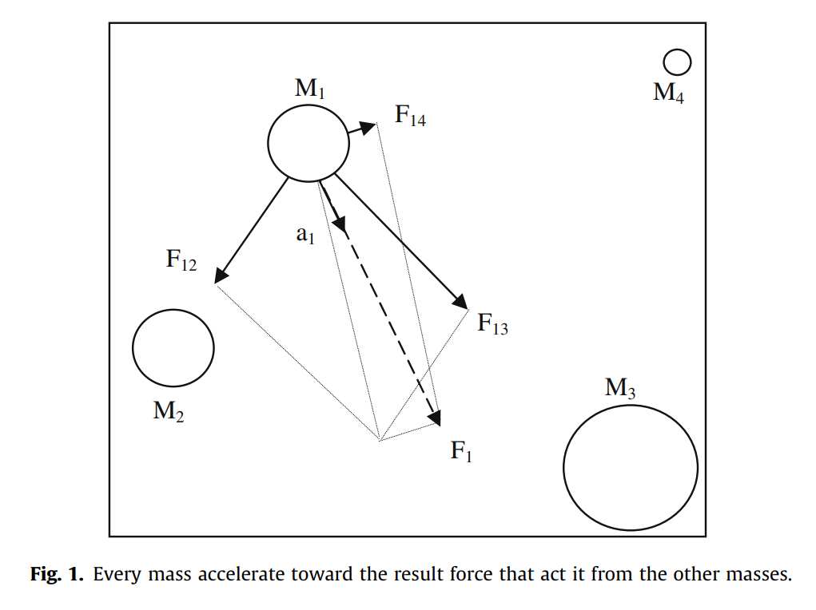
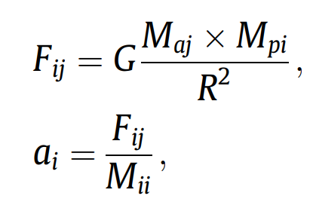
Active gravitational mass, Ma - strength of exerted gravity field
Passive gravitational mass, Mp - strength of interaction with the gravitational field
Inertial mass, Mi - resistance to change when a force is applied
between masses i and j

Slide 10
Algorithm setup
isolated system of masses
Newton’s laws
agents = objects
performance = mass
communication = gravitational force
objects attract each other by the gravity force
global movement towards the heaviest mass (best performance)
heavier objects move slower - exploitation
Each agent has:
position (corresponds to a solution of the problem)
inertial mass Mi
active gravitational mass Ma
passive gravitational mass Mp

Slide 11
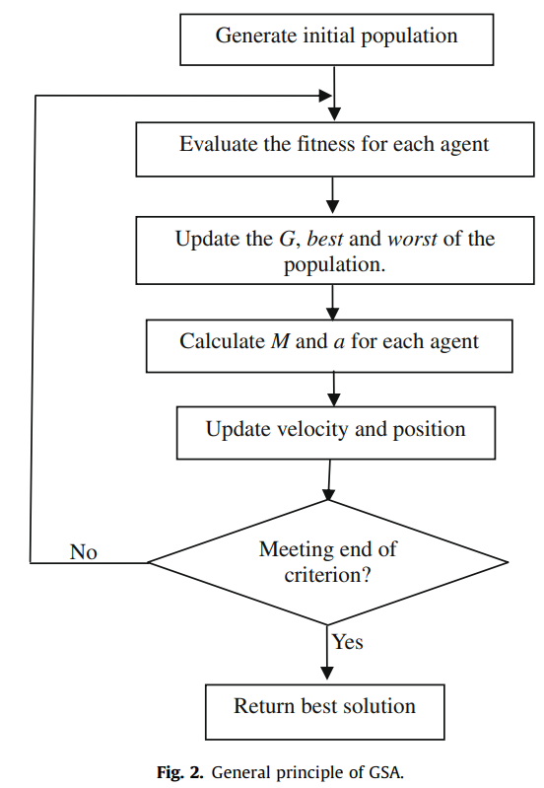
Algorithm
best_agent = null
fits = null
agents = <Agent>(N) // initialize randomly
while(true):
for agent in agents:
fitness = fit(agent)
fits.add(fitness)
update_G()
update_best_and_worst()
update_masses()
calculate_force() // in all directions
calculate_a_and_v()
move()
if(fitness <= criterion):
best_agent = agent
break
return best_agent
*https://github.com/himanshuRepo/Gravitational-Search-Algorithm
Notes:
a) Search space identification.
(b) Randomized initialization.
(c) Fitness evaluation of agents.
(d) Update G(t), best(t), worst(t) and Mi(t) for i = 1,2,...,N.
(e) Calculation of the total force in different directions.
(f) Calculation of acceleration and velocity.
(g) Updating agents’ position.
(h) Repeat steps c to g until the stop criteria is reached.
(i) End.

Slide 12
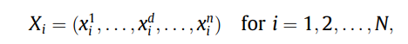
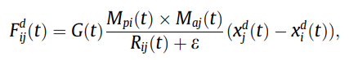
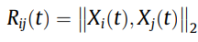
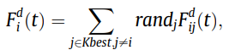
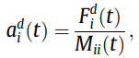
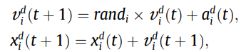
Calculation
position of agent i, xd - in dimension d
force from agent j on i at moment t along dim d
, Euclidian distance between agents i and j in moment t
total force on agent i - weighted sum of forces from Kbest
agents, randomization makes the algorithm stochastic
acceleration of agent i in dimension d in moment t
velocity of agent i in moment t+1
position of agent i in moment t+1, rand [0, 1]
Notes:
ne way to perform a good compromise between exploration and exploitation is to reduce the number of agents with lapse of time in Eq. (9). Hence, we propose only a set of agents with bigger mass apply their force to the other. However, we should be careful of using this policy because it may reduce the exploration power and increase the exploitation capability. We remind that in order to avoid trapping in a local optimum the algorithm must use the exploration at beginning. By lapse of iterations, exploration must fade out and exploitation must fade in. To improve the performance of GSA by controlling exploration and exploitation only the Kbest agents will attract the others. Kbest is a function of time, with the initial value K0 at the beginning and decreasing with time. In such a way, at the beginning, all agents apply the force, and as time passes, Kbest is decreased linearly and at the end there will be just one agent applying force to the others. Therefore, Eq. (9) could be modified as:

Slide 13
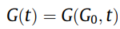
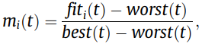
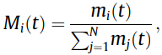
Calculation pt 2
, gravitational constant can be adjusted by initial parameters
assuming all masses for one object are equal
, mass position of agent i in moment t
mass of agent i in moment t - in relation to other objects’ masses
worst(t) and best(t) are chosen as max and min of fitj(t) for all j in tasks of minimization and min and max in maximization
fit(t) is the metric used to evaluate the solution
Notes:
ne way to perform a good compromise between exploration and exploitation is to reduce the number of agents with lapse of time in Eq. (9). Hence, we propose only a set of agents with bigger mass apply their force to the other. However, we should be careful of using this policy because it may reduce the exploration power and increase the exploitation capability. We remind that in order to avoid trapping in a local optimum the algorithm must use the exploration at beginning. By lapse of iterations, exploration must fade out and exploitation must fade in. To improve the performance of GSA by controlling exploration and exploitation only the Kbest agents will attract the others. Kbest is a function of time, with the initial value K0 at the beginning and decreasing with time. In such a way, at the beginning, all agents apply the force, and as time passes, Kbest is decreased linearly and at the end there will be just one agent applying force to the others. Therefore, Eq. (9) could be modified as:

Slide 14
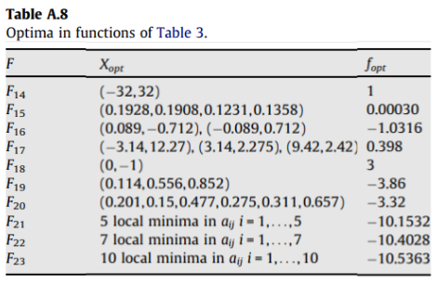
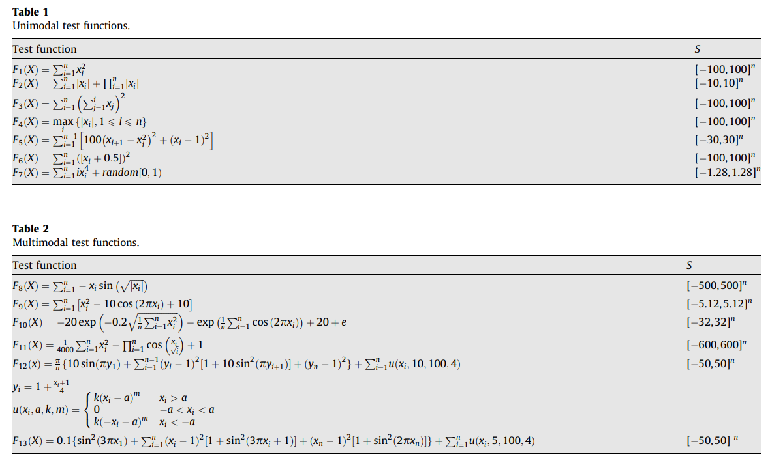
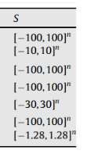
Input

Slide 15
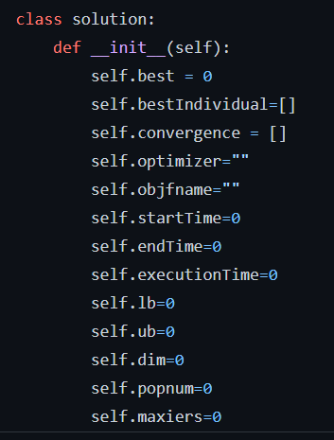
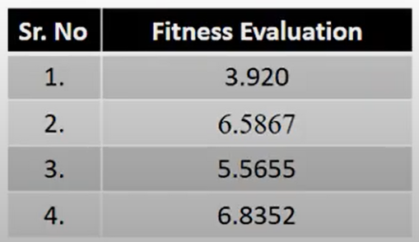
Output

Slide 16
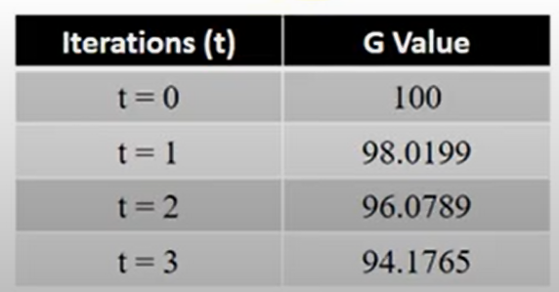
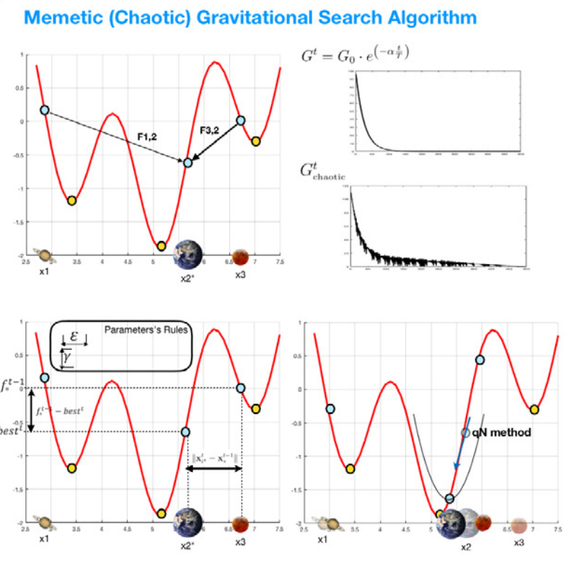
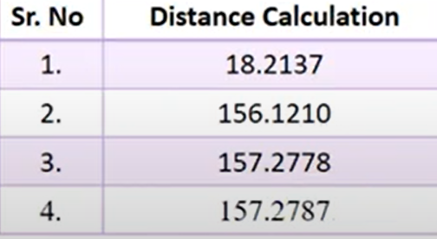
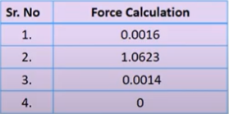
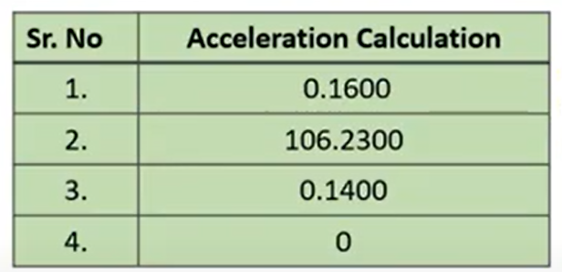
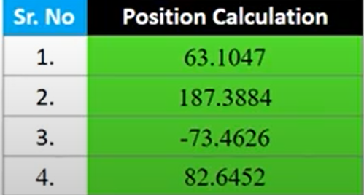
Action

Slide 17
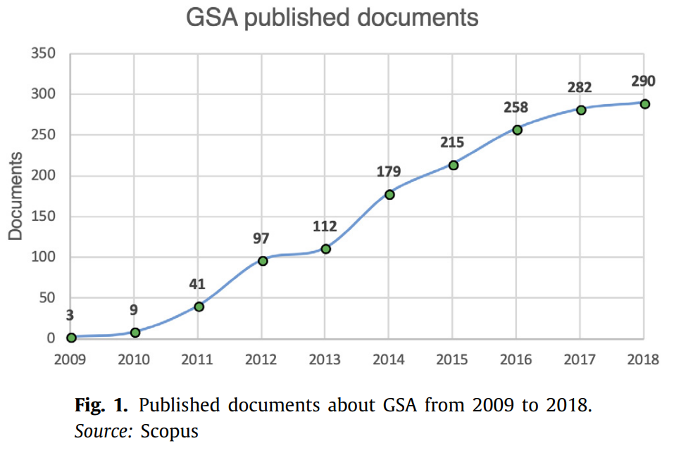
Application
Economic Load Dispatch
Clustering problem
Feature subset selection
Parameter identification
Training neural networks
Travelling salesman problem
Filter design and communication systems
Multi-objective optimisation
…. and more
Notes:
Economic Load Dispatch (ELD) is a method of determining the most efficient, low-cost and reliable operation of a power system by dispatching available electricity generation resources to supply load on the system most economically. The ELD problem is multimodal, non-differentiable and highly nonlinear. T
The FSS problem refers to the task of identifying and discovering a useful subset of features to represent a pattern from a larger set of features which may be redundant and even irrelevant causing unnecessary computational complexity and cost

Slide 18
Performance
Compared to:
Real Genetic Algorithm (RGA)
PSO - stochastic heuristic search based on social behavior in a flock of birds
Central Force Optimization (CFO) - deterministic heuristic search based on the metaphor of gravitational kinematics
on 23 standard benchmark functions
“The results obtained by GSA in most cases provide superior results and in all cases are comparable with PSO, RGA and CFO. Finally it must be noted that a local search after found result may be beneficial.”
Notes:
GSA versus PSO
In both GSA and PSO the optimization is obtained by agents movement in the search space, however the movement strategy is different. Some important differences are as follows:
– In PSO the direction of an agent is calculated using only two best positions, pbesti and gbest. But in GSA, the agent direction is calculated based on the overall force obtained by all other agents.
– In PSO, updating is performed without considering the quality of the solutions, and the fitness values are not important in the updating procedure while in GSA the force is proportional to the fitness value and so the agents see the search space around themselves in the influence of force.
– PSO uses a kind of memory for updating the velocity (due to pbesti and gbest). However, GSA is memory-less and only the current position of the agents plays a role in the updating procedure.
– In PSO, updating is performed without considering the distance between solutions while in GSA the force is reversely proportional to the distance between solutions.
– Finally, note that the search ideas of these algorithms are different. PSO simulates the social behavior of birds and GSA inspires by a physical phenomena
GSA versus CFO
In both CFO and GSA the probes positions and accelerations are inspired by particle motion in a gravitational field but they use different formulations.
– One of major differences is that CFO is inherently deterministic and does not use any random parameter in its formulation while GSA is a stochastic search algorithm.
– The acceleration and movement expressions and calculation of the masses in GSA are different from CFO.
– In CFO, the initial probe distribution is systematic (based on a deterministic rule) and has a significant effect on the algorithm’s convergence but in GSA the initial distribution is random.
– Another difference is that in CFO, G is a constant while in GSA, G is a control parameter

Slide 19
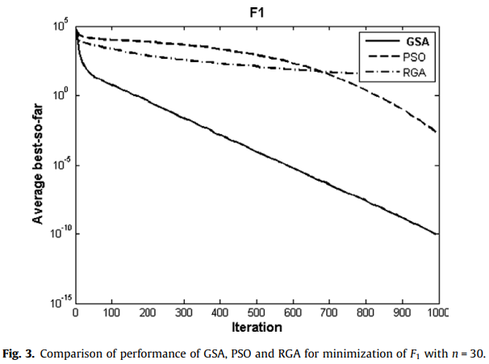
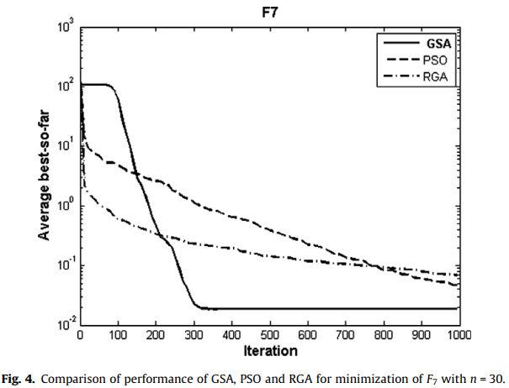

Slide 20
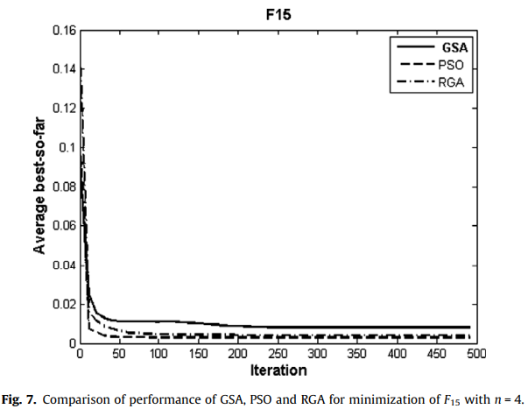
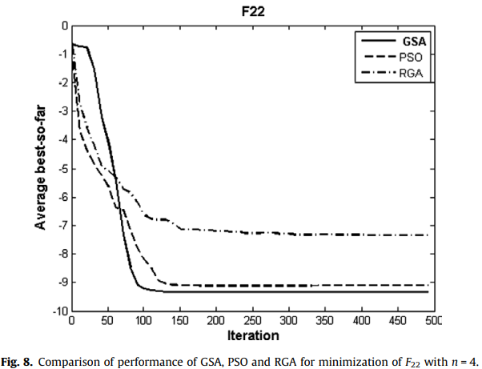

Slide 21
Advantages
gravitational force is an information-transferring tool observed by all agents
objects see space around them
mass = performance
agents move towards the best agent
agents with big Mi move slowly and search the space more locally ~ adaptive learning rate
gravitational constant decreases with time => adjusts the accuracy of the search
memory-less algorithm
Mp, Ma and Mi can be made different
Notes:
A bigger inertia mass provides a slower motion of agents in the search space and hence a more precise search. Conversely, a bigger gravitational mass causes a higher attraction of agents. This permits a faster convergence.

Slide 22
References
Rashedi E., Nezamabadi-Pour H., Saryazdi S. GSA: a gravitational search algorithm //Information sciences. – 2009. – Т. 179. – №. 13. – С. 2232-2248.
Optimization vs. heuristics // icron URL: https://www.icrontech.com/blog_item/optimization-vs-heuristics-which-is-the-right-approach-for-your-business/ (дата обращения: 20.10.2022).
Ricardo García-Ródenas, Luis Jiménez Linares, Julio Alberto López-Gómez, A Memetic Chaotic Gravitational Search Algorithm for unconstrained global optimization problems,Applied Soft Computing,Volume 79,2019,Pages 14-29, ISSN 1568-4946
Siddique, Nazmul & Adelib, Hojjat. (2016). Applications of gravitational search algorithm in engineering. Journal of Civil Engineering and Management. 22. 981-990. 10.3846/13923730.2016.1232306.

Slide 23
Thank you for your attention!

